Slide 1
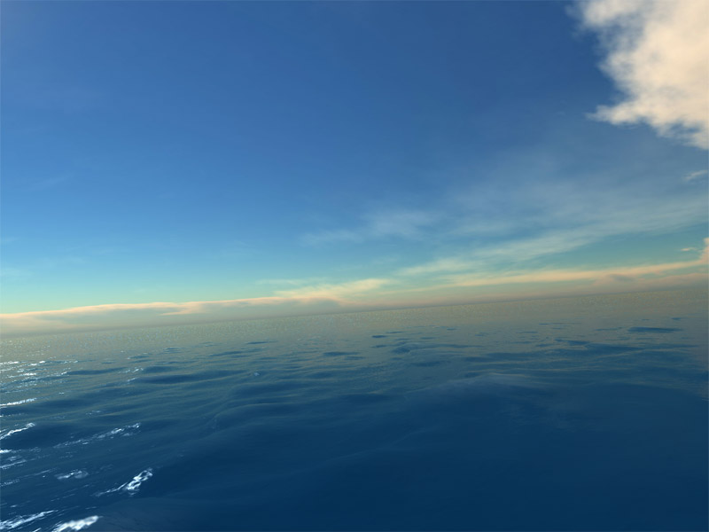
Exploring the Oceans
Chapter 13
Section 1

Slide 2
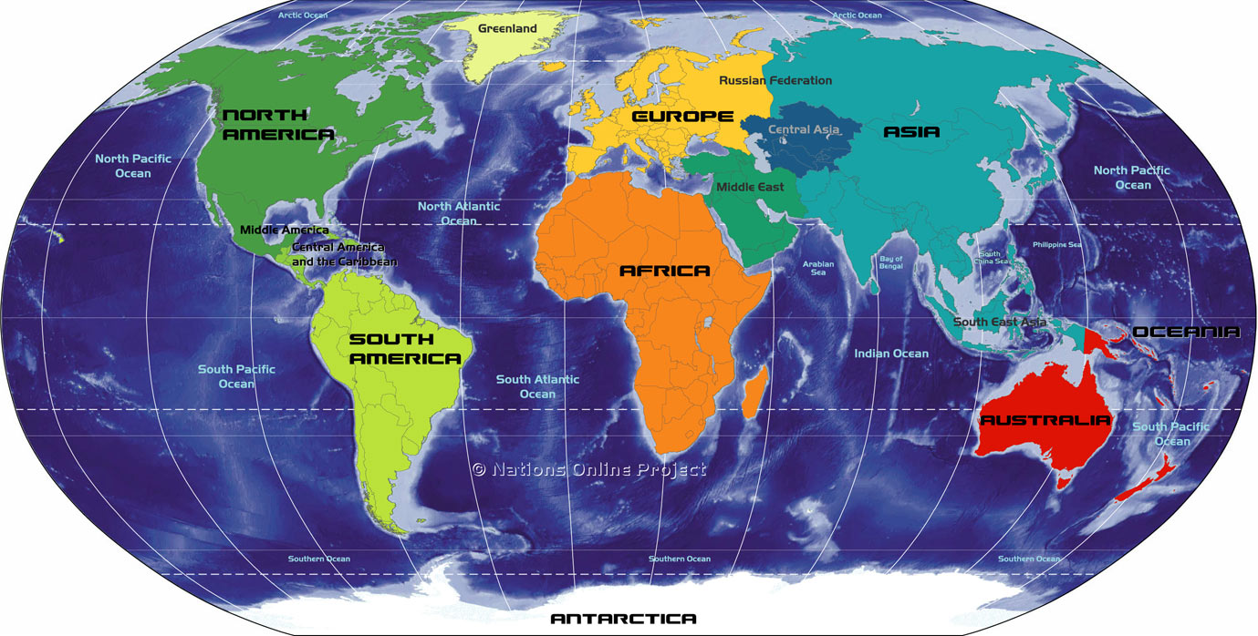

Slide 3
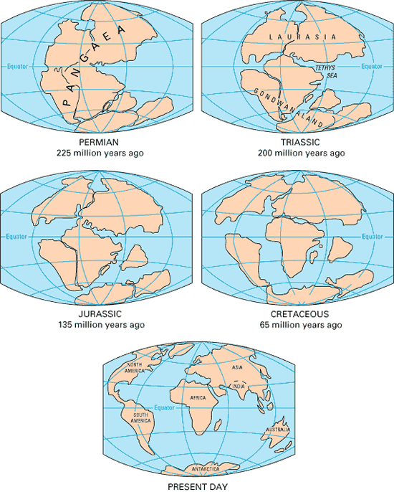
Pangaea broke apart to form our oceans that we have today.
The first oceans began to form sometime before 4 billion years ago, as the Earth cooled enough for water vapor to condense and fall as rain.

Slide 4
WATER!
In addition to being vital to life, water plays a significant role in many of Earth’s processes. Almost 80% of Earth is covered by water.
Salt water makes up 97% of all the water on Earth
2% is frozen in ice caps and glaciers
1% is fresh water. (This is the only water humans can drink).

Slide 5
Water is a Natural Resource!
Because fresh water must be used for other human activities like farming, we must practice conservation of fresh water.
There is a limited supply of fresh water on Earth.
In times of drought, where there is little rain, humans need to make plans to conserve water, such as not watering lawns or filling up their swimming pools.

Slide 6
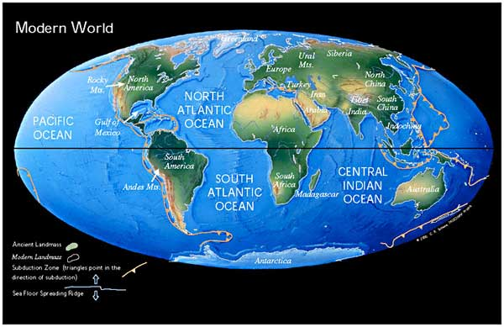
71% of the Earth is WATER!

Slide 7
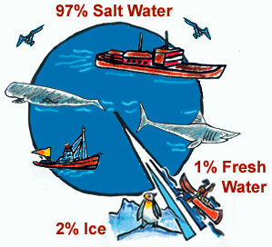
97% of the water on Earth is salt water.

Slide 8
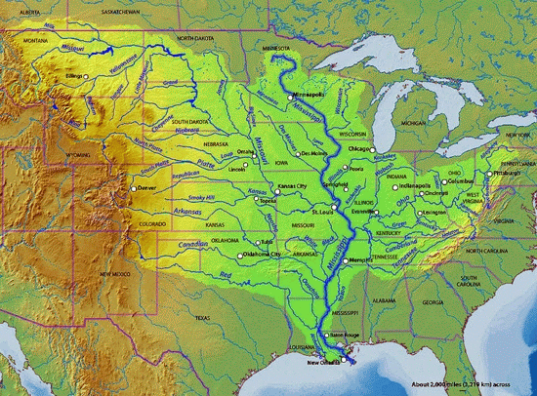
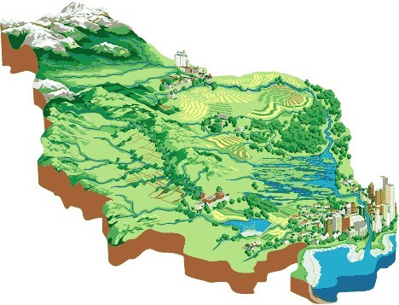
Why is it salty?
When water drains from land it weathers rock and dissolves minerals, carrying them to the ocean.
At the same time, water is evaporating from the ocean, leaving behind the solids.

Slide 9
Ocean Currents
A current is the continuous flow of ocean water. Currents can be described as either surface currents or deep-ocean currents.
Many forces act on the flow of these currents.
Waves, caused by the wind, act on surface currents
Differences in density, in temperature, and in salinity all have an impact on the flow of deep-ocean currents

Slide 10
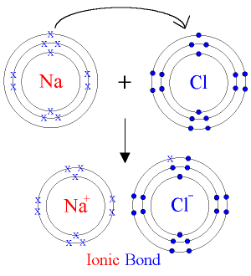
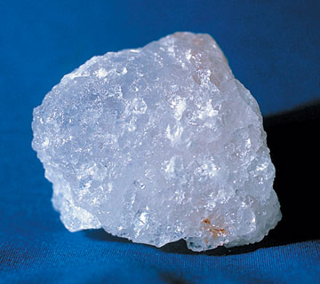
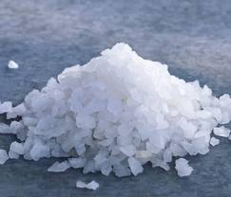
Sodium and chlorine are the two most abundant elements in the ocean.
This makes sodium chloride (NaCl) the most abundant compound in the ocean.

Slide 11
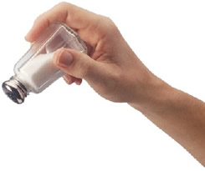
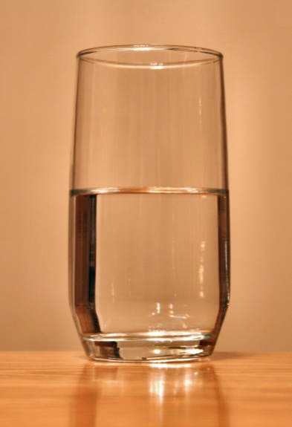
Salinity
The amount of dissolved solids in a given amount of liquid.
Which has a higher salinity?
OR

Slide 12
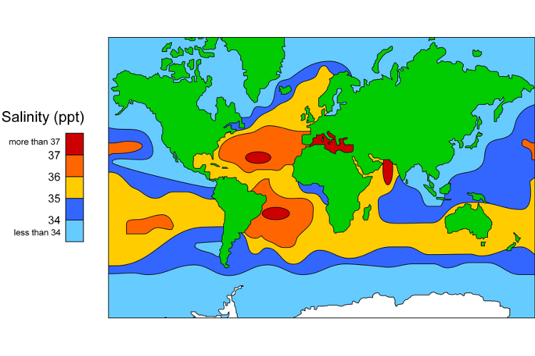
Salinity of the Ocean
Do you see any patterns?

Slide 13
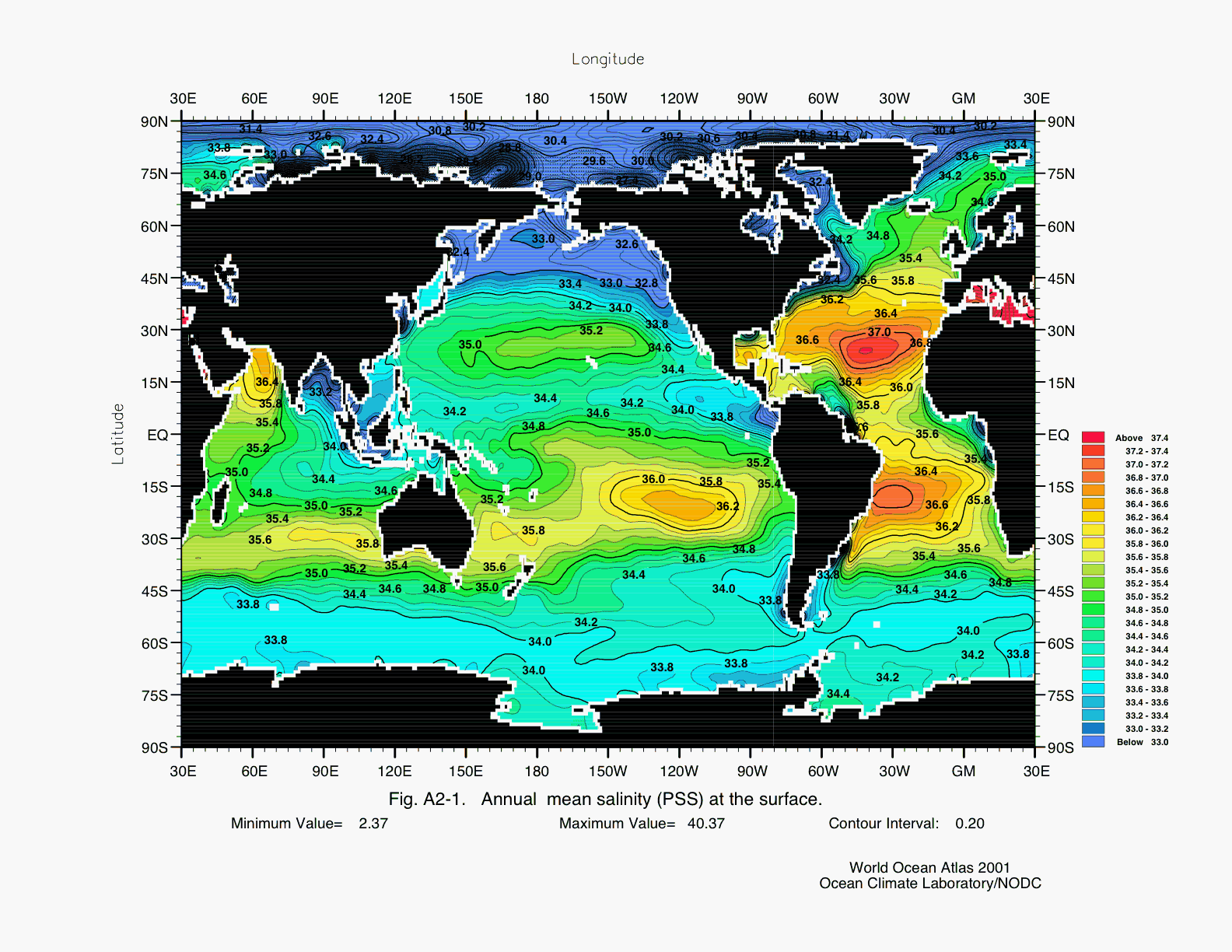
Climate affects salinity.
Temperature affects the evaporation rate, so the water has a higher salinity.
Ocean water has a lower salinity at the mouth of rivers because there is more fresh water.

Slide 14
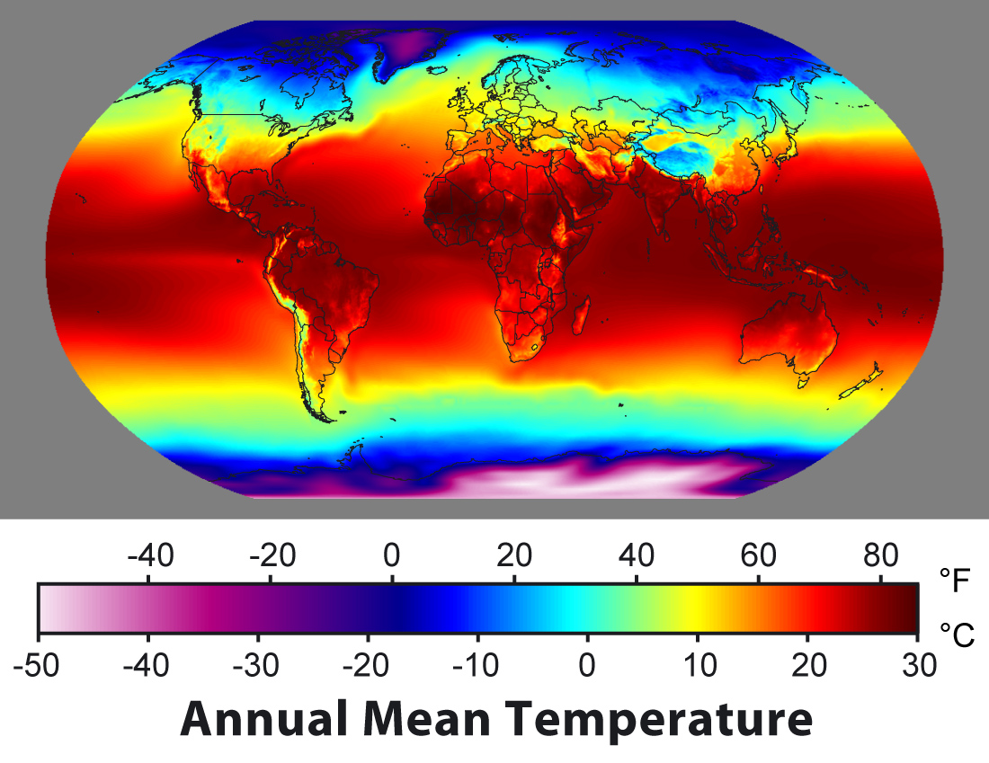
The Ocean Holds Heat
The ocean absorbs and loses heat much slower than dry land. This helps the earth hold its steady temperature.

Slide 15
Why is the ocean warmer near the equator?

Slide 16
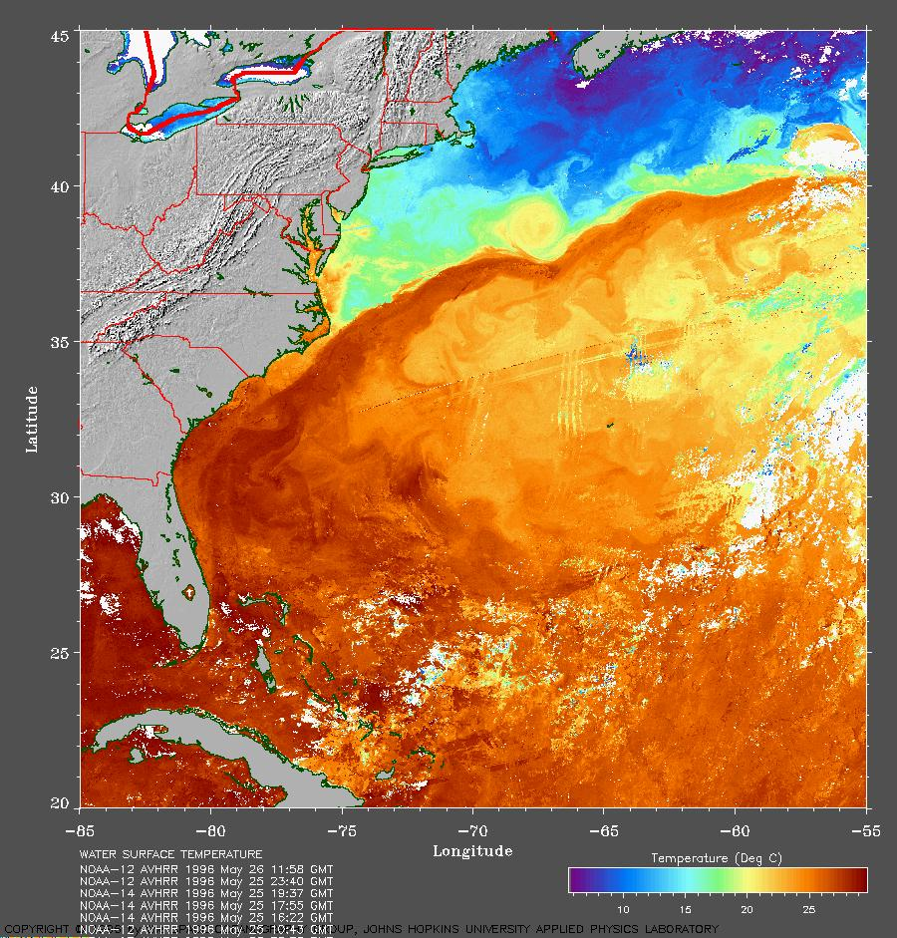
Heat Travels
The ocean also helps regulate temperatures in other parts of the world.

Slide 17
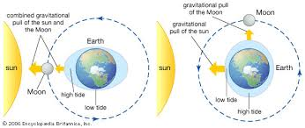
Tides
Tides are caused by the gravitational pull from the Sun and Moon on the ocean water.

Slide 18
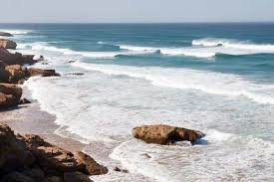
Waves
Waves are created when wind moves across the surface of water and pushes the water. The energy from the wind is transferred to the water.
Waves can also be created when the energy from the waves created by earthquakes is transmitted to the water in the oceans.

Slide 19
Why are oceans salty?
The amount of salt in the ocean, also known as salinity, is largely caused by the runoff from rivers and streams that carry minerals into the oceans.
Salt is a mineral and can be found in soil and rocks.
The runoff of water has carried and continues to carry salt into the ocean.

Slide 20
Salt Water
Salt water is dangerous for humans to drink.
Our bodies have a safe level of salts in them. When people drink salt water, their body will try to get rid of the excess salt by making more water leave their body, mostly through urine.
This is why you should never drink salt water when stranded at sea. You may be thirsty, but by drinking salt water, you will make yourself thirstier. Without enough water, your cells and organs cannot function properly.

Slide 21
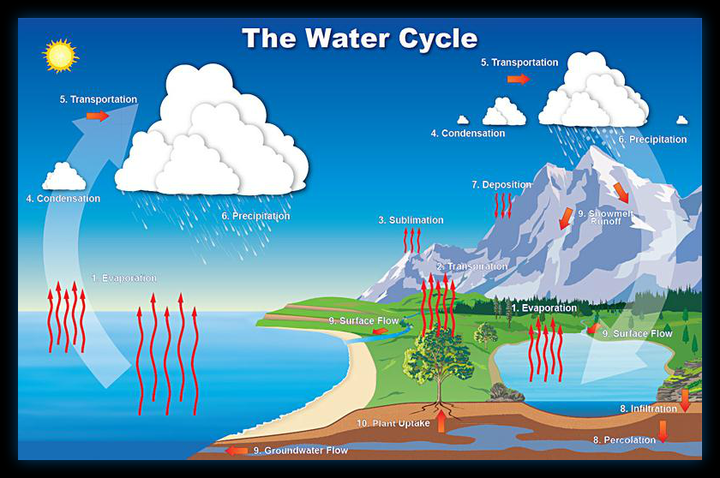
The Water Cycle
The water cycle is the process that moves water above, below, and around the Earth in a cycle. The water cycle has four main stages:
Evaporation
Condensation
Precipitation
Collection

Slide 22
The Water Cycle
The Sun heats up liquid water and causes it to evaporate.
The water vapor, which is a gas, then rises up into the atmosphere.
When atmospheric conditions are right, the water vapor forms clouds as it cools. The clouds then release water as precipitation, in the form of rain and snow.

Slide 23
As the water runs off, it is collected into the ground and bodies of water.
The Sun then heats the liquid water up, causing it to evaporate and the water cycle starts all over again.

