Slide 1
The Ocean Floor
Chapter 13
Section 2

Slide 2
Ocean Topography
The subsurface topography of the ocean describes the features of the ocean floor.
Much like there are hills and valleys on land, the ocean floor is composed of many geological features.
There are flat valleys where sediment is deposited as it is eroded from rivers.
There are mountains on the ocean floor. There are valleys and very deep trenches that are thousands of kilometers long.
There are also active and inactive volcanoes.

Slide 3
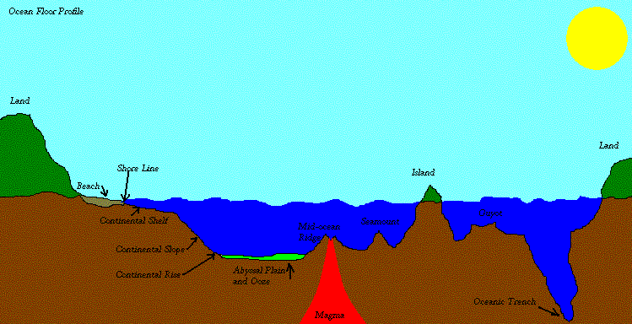
The Ocean Floor

Slide 4
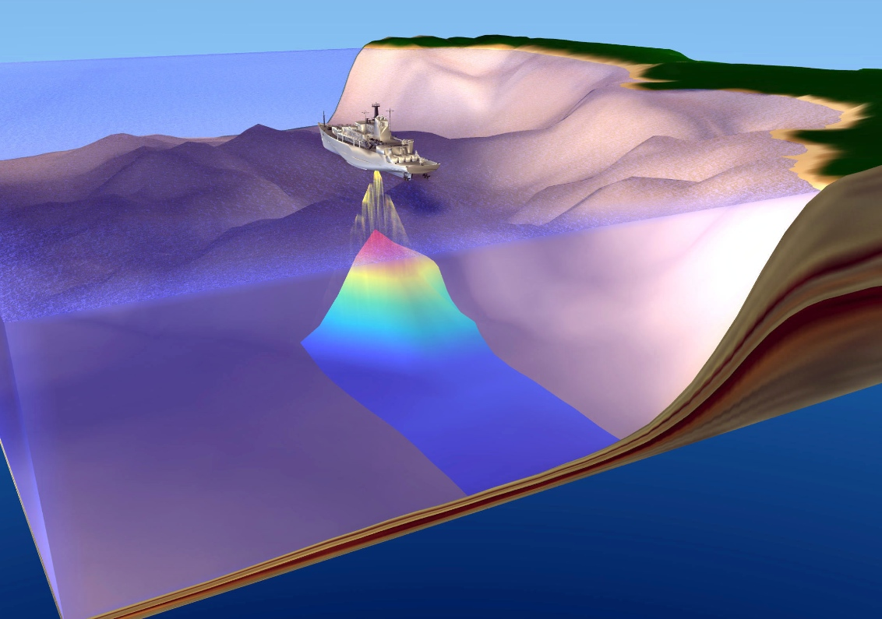
Seeing by SONAR
SOund Navigation And Ranging
A ship sends sound waves to the ocean floor.
The sound waves bounce off the floor and back to the ship.
The deeper the water, the longer it takes for the sound waves to return.

Slide 5
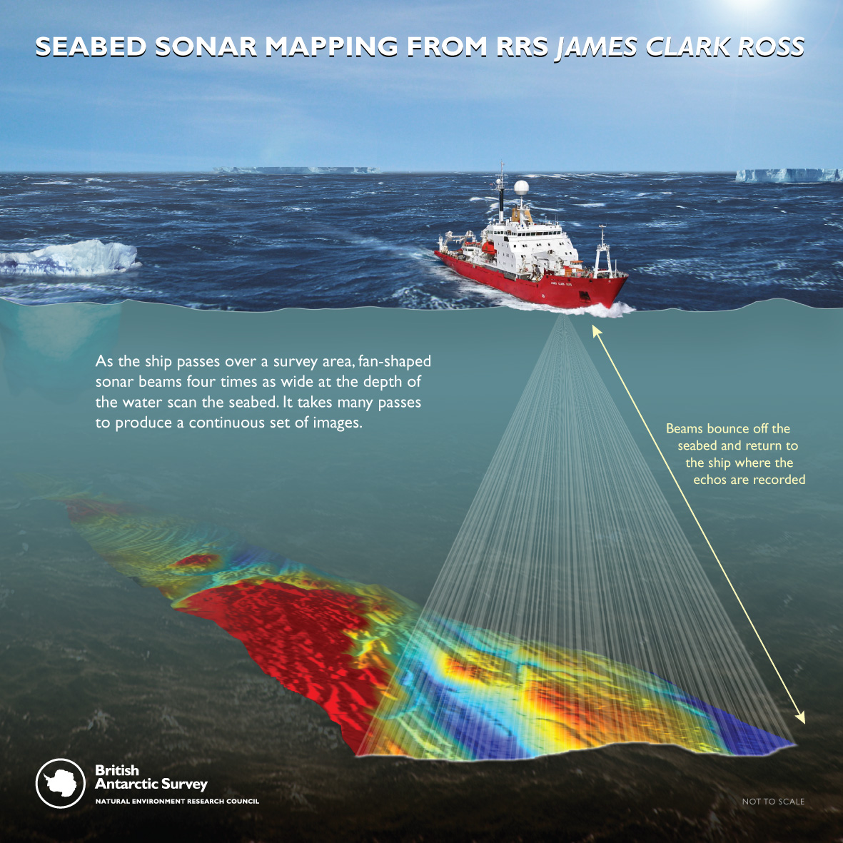

Slide 6
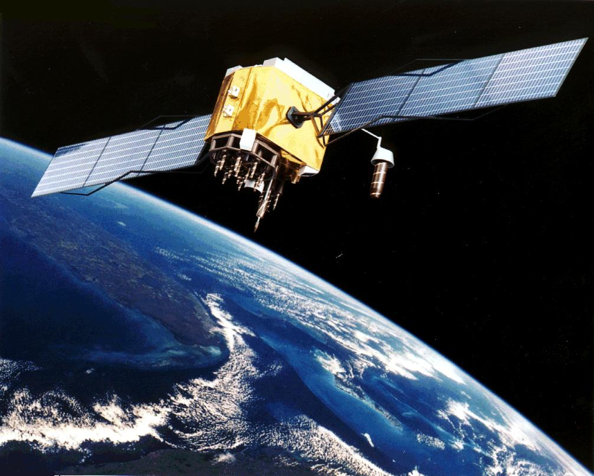
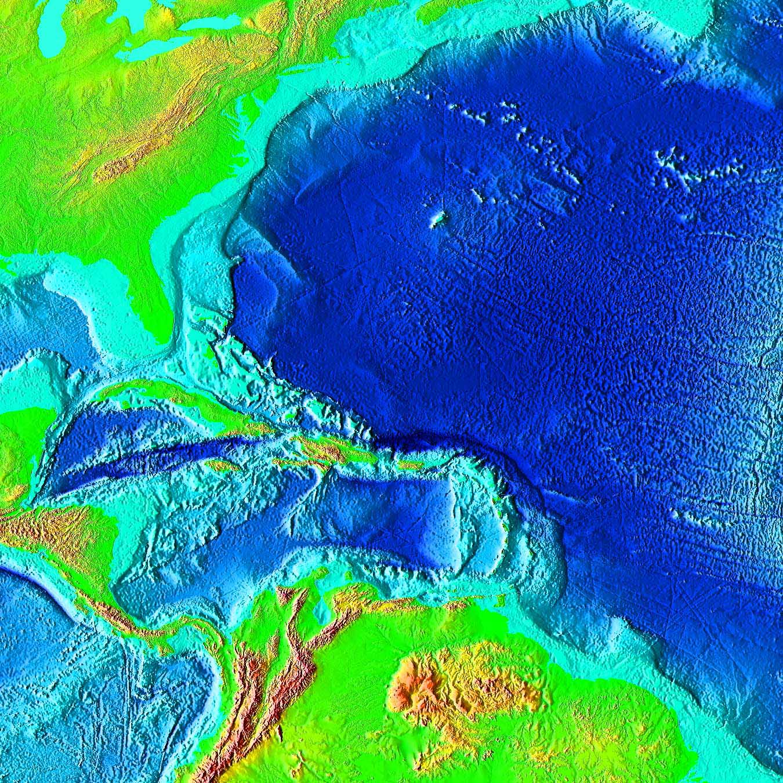
Another way to study the ocean floor is with satellites.

Slide 7
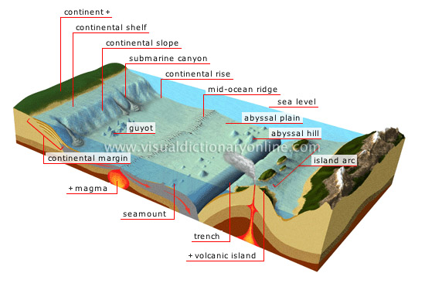
The Ocean Floor

Slide 8
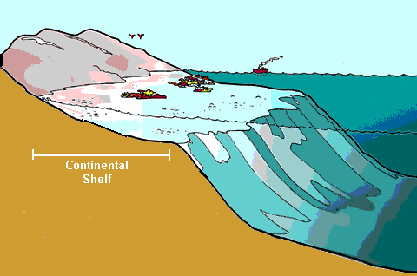
Continental Shelf
Begins at the shoreline and slopes gently toward the open ocean.

Slide 9
Continental Slope
Begins at the edge of the continental shelf and continues down to the flattest part of the ocean floor

Slide 10
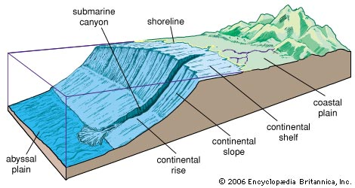
Continental Rise
Made of large piles of sediment and found at the base of the continental slope

Slide 11
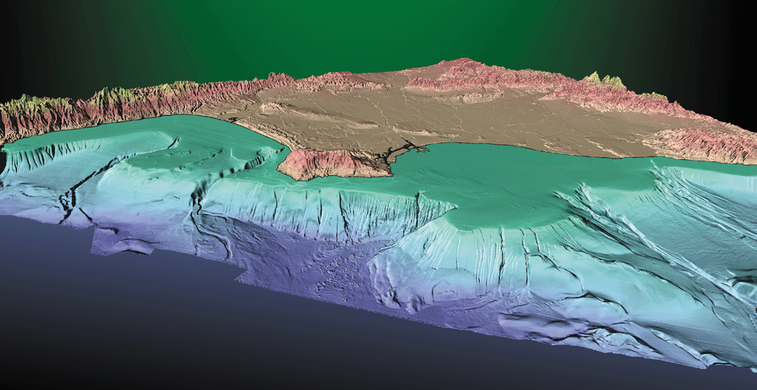
Can you find the continental Shelf, slope and rise?

Slide 12
Abyssal Plain
Broad flat part of the ocean that is very deep and covered with mud and the remains of decomposing organisms

Slide 13
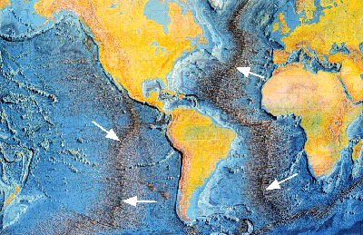
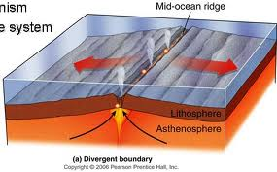
Mid-Ocean Ridge
Mountain chains that form when tectonic plates pull apart at divergent boundaries

Slide 14
Rift Valley
The valley that forms when tectonic plates separate

Slide 15
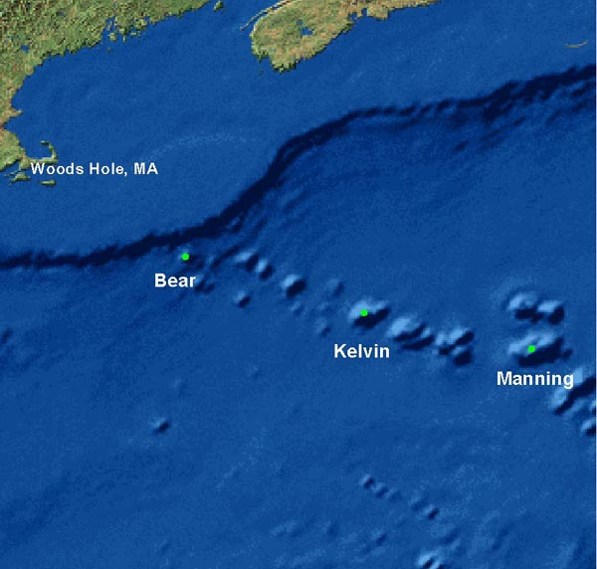
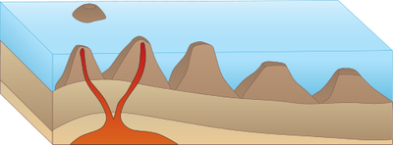
Seamounts
Mountains of volcanic material that do not build up enough to break the surface
Seamounts

Slide 16
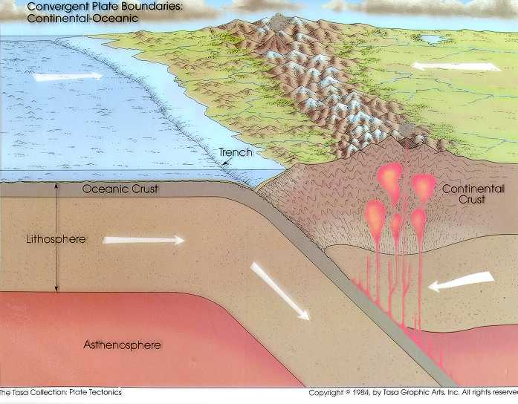
Ocean Trench
Large cracks in the ocean floor that form at convergent boundaries

Slide 17
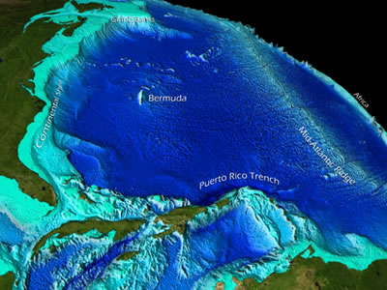
Can you find all of the following:
Continental Shelf
Continental Slope
Continental Rise
Abyssal Palin
5. Mid-Ocean Ridge
6. Rift valley
7. Seamounts
8. Ocean trench

