Slide 1
Chapter 14 Sec. 2
Currents and Climate

Slide 2
What ???????
The Scilly Isles in England are located as far north as Newfoundland in northeast Canada.
But the Scilly Isles experience warm temperatures almost all year long, while Newfoundland has long winters of frost and snow.
How can two places at similar latitudes have completely different climates?
This difference in climate is caused by surface currents.

Slide 3
What You Will Learn
Explain how currents affect climate.
Describe the effects of El Niño.
Explain how scientists study and predict the pattern of El Niño.

Slide 4
Surface Currents and Climate
Surface currents greatly affect the climate in many parts of the world.
Some surface currents warm or cool coastal areas year-round.
Other surface currents sometimes change their circulation pattern.
Changes in circulation patterns cause changes in atmosphere that affect the climate in many parts of the world.

Slide 5
Warm-Water Currents and Climate
Although surface currents are generally much warmer than deep currents, the temperatures of surface currents do vary.
Surface currents are classified as warm-water currents or cold-water currents.
Warm-water currents create warmer climates in coastal areas that would otherwise be much cooler.

Slide 6
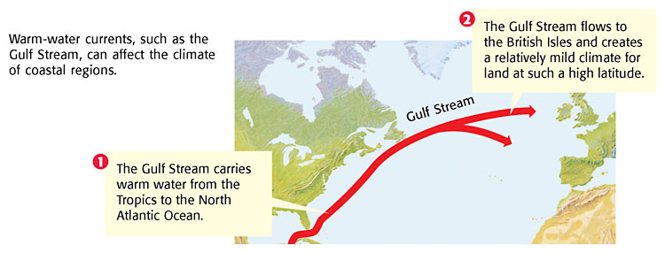

Slide 7
Cold-Water Currents and Climate
Cold-water currents also affect the climate of the land near where they flow.
Figure 2 shows how the California Current carries cold water from the North Pacific Ocean southward to Mexico.
The cold-water California Current keeps the climate along the West Coast cooler than the inland climate year-round.

Slide 8
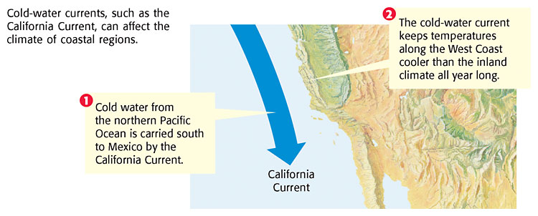

Slide 9
Upwelling
  When local wind patterns blow along the north-west coast of South America, they cause local surface currents to move away from the shore.
  This warm water is then replaced by deep, cold water.
  This movement causes upwelling to occur in the eastern Pacific.

Slide 10
Upwelling Continued
  Upwelling is a process in which cold, nutrient-rich water from the deep ocean rises to the surface and replaces warm surface water, as shown in Figure 3.
    The nutrients from the deep ocean are made up of elements and chemicals, such as iron and nitrate.
    When these chemicals are brought to the sunny surface, they help tiny plants grow through the process of photosynthesis.

Slide 11
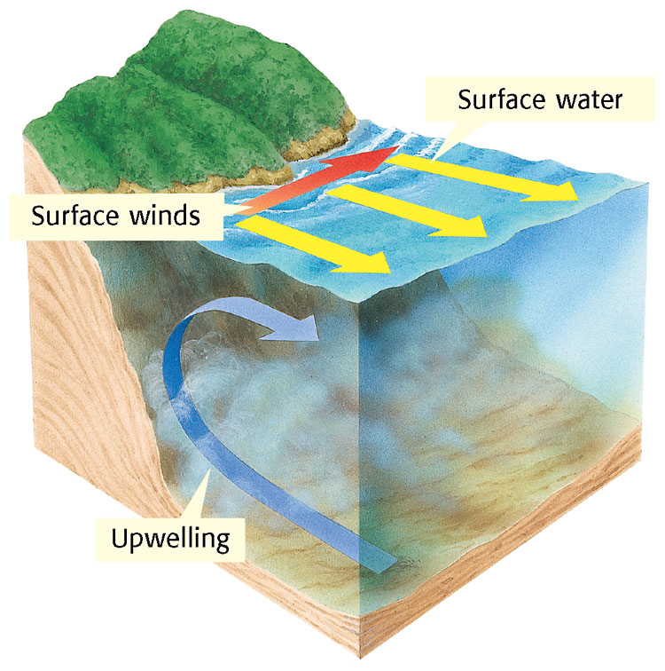

Slide 12
El Niño
Every 2 to 12 years, the South Pacific trade winds move less warm water to the western Pacific than they usually do.
Thus, surface-water temperatures along the coast of South America rise.
Gradually, this warming spreads westward. This periodic change in the location of warm and cool surface waters in the Pacific Ocean is called El Niño.
El Niño can last for a year or longer and not only affects the surface waters but also changes the interaction of the ocean and the atmosphere, which in turn changes global weather patterns.

Slide 13
La Nina
Sometimes, El Niño is followed by La Niña.
La Niña is a periodic change in the eastern Pacific Ocean in which the surface-water temperature becomes unusually cool.
Like El Niño, La Niña also affects weather patterns.

Slide 14
Effects of El Niño
El Niño alters weather patterns enough to cause disasters.
These disasters include flash floods and mudslides in areas of the world that usually receive little rain, such as the southern half of the United States and Peru.
While some regions flood, regions that usually get a lot of rain may experience droughts, an unusually long period during which rainfall is below average.
During El Niño, severe droughts can occur in Indonesia and Australia. Periods of severe drought can lead to crop failure

Slide 15
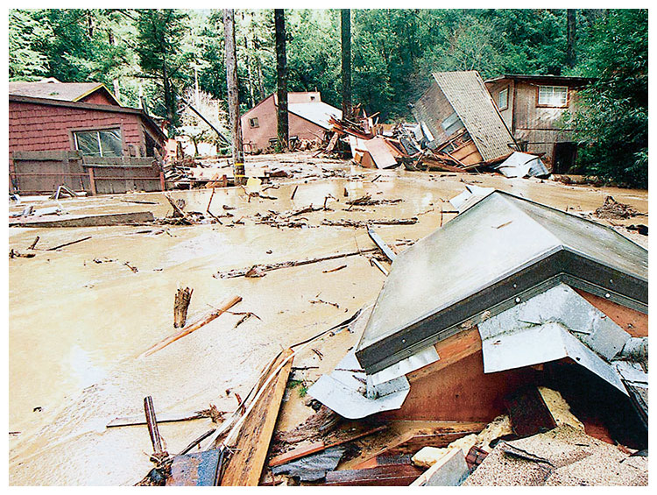

Slide 16
Studying and Predicting El Niño
Because El Niño occurs every 2 to 12 years, studying and predicting it can be difficult.
However, it is important for scientists to learn as much as possible about El Niño because of its effects on organisms and land.

Slide 17
One way scientists collect data to predict an El Niño is through a network of buoys operated by the National Oceanic and Atmospheric Administration (NOAA).
The buoys, some of which are anchored to the ocean floor, are located along the Earth’s equator.
The buoys record data about surface temperature, air temperature, currents, and winds.
The buoys transmit some of the data on a daily basis to NOAA through a satellite in space

