Slide 1
Chapter 14 Sec 3
Waves

Slide 2
What You Will Learn
Identify the parts of a wave.
• Explain how the parts of a wave relate to wave movement.
• Describe how ocean waves form and move.
• Classify types of waves.

Slide 3
Have you seen a wave?
We all know what ocean waves look like. Even if you’ve never been to the seashore, you’ve most likely seen waves on TV.
But how do waves form and move? Waves are affected by a number of different factors.
They can be formed by something as simple as wind or by something as violent as an earthquake.
Ocean waves can travel through water slowly or incredibly quickly.

Slide 4
Anatomy of a Wave
Waves are made up of two main parts—crests and troughs.
A crest is the highest point of a wave.
A trough is the lowest point of a wave.
The distance between two adjacent wave crests or wave troughs is a wavelength.
The vertical distance between the crest and trough of a wave is called the wave height.

Slide 5
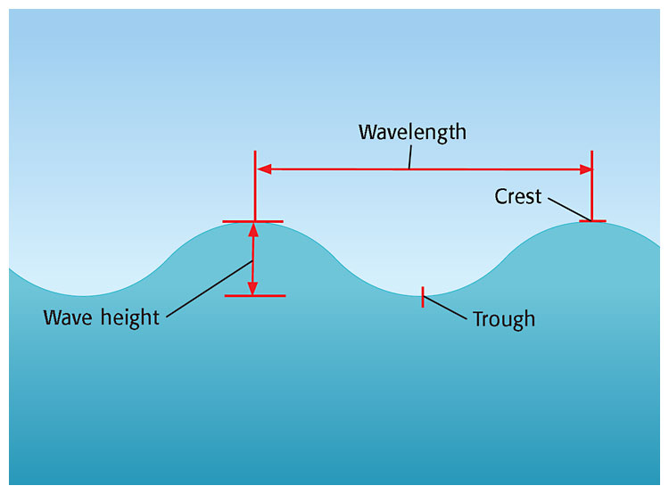

Slide 6
Wave Formation and Movement
If you have watched ocean waves before, you may have noticed that water appears to move across the ocean’s surface.
However, this movement is only an illusion.
Most waves form as wind blows across the water’s surface and transfers energy to the water.
As the energy moves through the water, so do the waves. But the water itself stays behind, rising and falling in circular movements.

Slide 7
Wave Formation Continued
Notice in Figure 2 that the floating bottle remains in the same spot as the waves travel from left to right.
This circular motion gets smaller as the water depth increases, because wave energy decreases as the water depth increases.
Wave energy reaches only a certain depth. Below that depth, the water is not affected by wave energy.

Slide 8
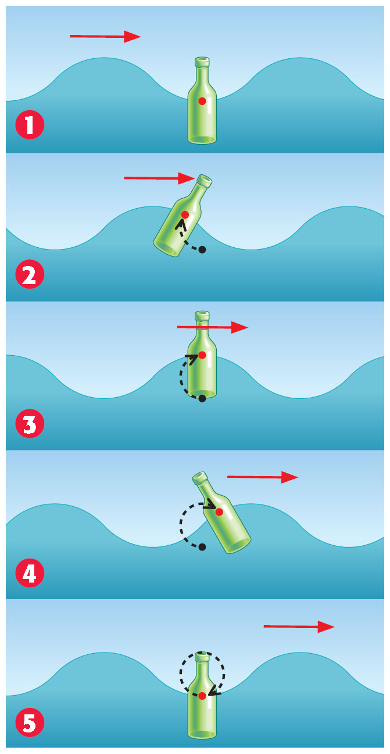

Slide 9
Specifics of Wave Movement
Waves not only come in different sizes but also travel at different speeds.
To calculate wave speed, scientists must know the wavelength and the wave period.
Wave period is the time between the passage of two wave crests (or troughs) at a fixed point, as shown in Figure 3.
Dividing wavelength by wave period gives you wave speed, as shown below.

Slide 10
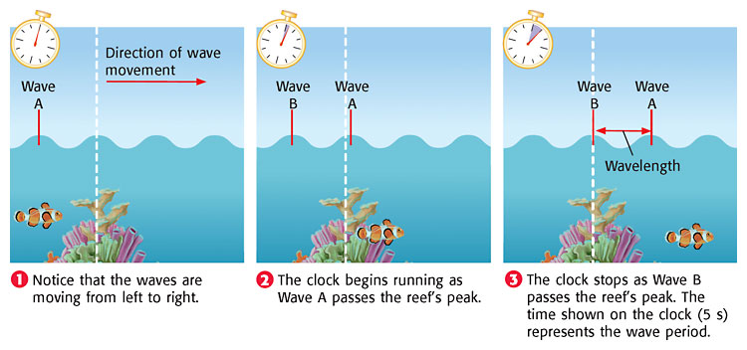

Slide 11
Types of Waves
As you learned earlier in this section, wind forms most ocean waves.
Waves can also form by other mechanisms.
Underwater earthquakes and landslides as well as impacts by cosmic bodies can form different types of waves.

Slide 12
Deep-Water Waves and Shallow-Water Waves
Have you ever wondered why waves increase in height as they approach the shore? The answer has to do with the depth of the water.
Deep-water waves are waves that move in water deeper than one-half their wavelength.
When the waves reach water shallower than one-half their wavelength, they begin to interact with the ocean floor. These waves are called shallow-water waves.

Slide 13
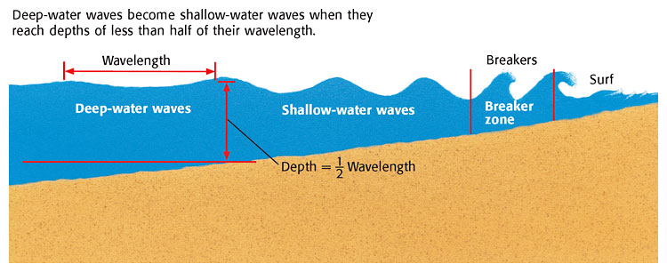

Slide 14
As deep-water waves become shallow-water waves, the water particles slow down and build up.
This change forces more water between wave crests and increases wave height.
Gravity eventually pulls the high wave crests down, which causes them to crash into the ocean floor as breakers.
The area where waves first begin to tumble downward, or break, is called the breaker zone.

Slide 15
Shore Currents
When waves crash on the beach head-on, the water they moved through flows back to the ocean underneath new incoming waves.
This movement of water, which carries sand, rock particles, and plankton away from the shore, is called an undertow.

Slide 16
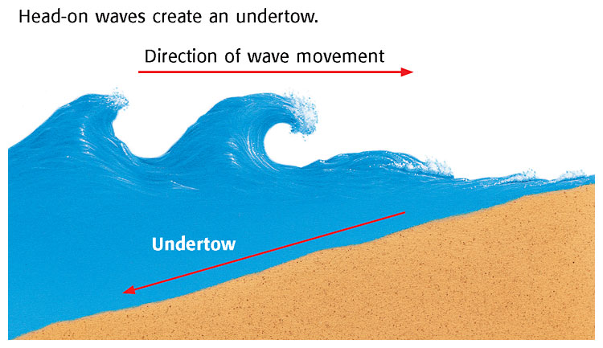

Slide 17
Longshore Currents
When waves hit the shore at an angle, they cause water to move along the shore in a current called a longshore current
Longshore currents transport most of the sediment in beach environments.
This movement of sand and other sediment both tears down and builds up the coastline.

Slide 18
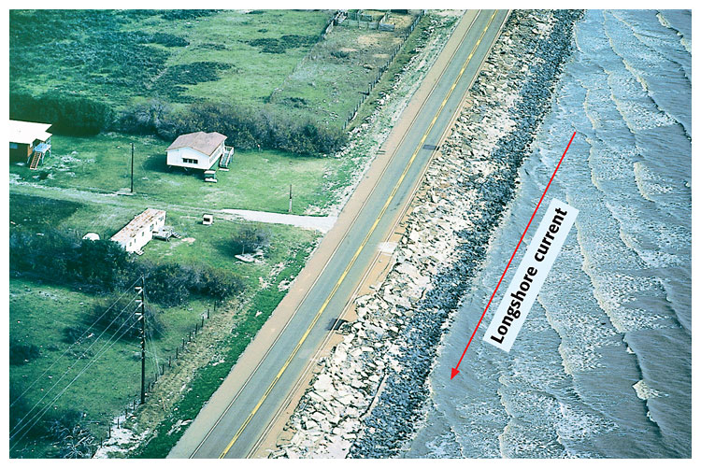

Slide 19
Tsunamis
Tsunamis are waves that form when a large volume of ocean water is suddenly moved up or down.
This movement can be caused by underwater earthquakes, volcanic eruptions, landslides, underwater explosions, or the impact of a meteorite or comet.
The majority of tsunamis occur in the Pacific Ocean because of the large number of earthquakes in that region.

Slide 20
