Slide 1
Chapter 14 Section 4
Tides
Ms. Coleman
Mr. Johnson

Slide 2
If you stand at some ocean shores long enough, you will see the edge of the ocean shrink away from you.
Wait longer, and you will see it return to its original place on the shore.
Would you believe the moon causes this movement?

Slide 3
What You Will Learn
Explain tides and their relationship with the Earth, sun, and moon.
Describe four different types of tides.
Analyze the relationship between tides and coastal land.

Slide 4
Tides
You have learned how winds and earthquakes can move ocean water.
But………there are less obvious forces that move ocean water in regular patterns called tides.
Tides are daily changes in the level of ocean water.
Tides are influenced by the sun and the moon

Slide 5
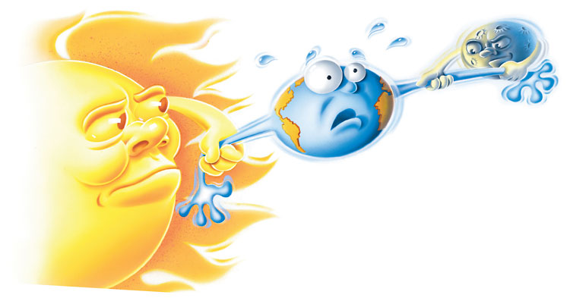
Although gravitational forces from both the sun and moon continuously pull on the Earth, the moon’s gravity is the dominant force on Earth’s tides

Slide 6
The Lure of the Moon
The phases of the moon and their relationship to the tides were first discovered more than 2,000 years ago by a Greek explorer named Pytheas.
But Pytheas and other early investigators could not explain the relationship.
A scientific explanation was not given until 1687, when Sir Isaac Newton’s theories on the principle of gravitation were published.

Slide 7
The lure of the moon Cont.
The gravity of the moon pulls on every particle of the Earth.
But the pull on liquids is much more noticeable than on solids, because liquids move more easily.
Even the liquid in a carton of milk is slightly pulled by the moon’s gravity.

Slide 8
High Tide and Low Tide
How often tides occur and the difference in tidal levels depend on the position of the moon as it revolves around the Earth.
The moon’s pull is strongest on the part of the Earth directly facing the moon.

Slide 9
Battle of the Bulge
When part of the ocean is directly facing the moon, the water there bulges toward the moon.
At the same time, water on the opposite side of the Earth bulges because of the rotation of the Earth and the motion of the moon around the Earth.
These bulges are called high tides.
Notice in Figure 2 how the position of the moon causes the water to bulge.
Also notice that when high tides occur, water is drawn away from the area between the high tides, which causes low tides to form.

Slide 10
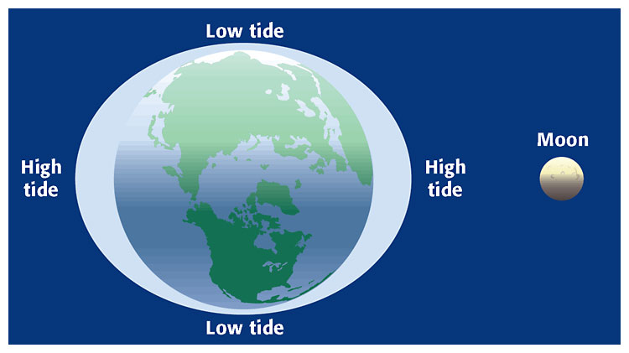

Slide 11
Timing the Tides
The rotation of the Earth and the moon’s revolution around the Earth determine when tides occur.
If the Earth rotated at the same speed that the moon revolves around the Earth, the tides would not alternate between high and low.
But the moon revolves around the Earth much more slowly than the Earth rotates.
  As Figure 3 shows, a spot on Earth that is facing the moon takes 24 h and 50 m to rotate and face the moon again.

Slide 12
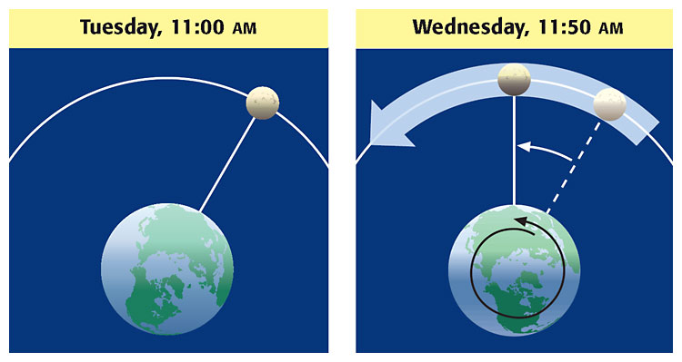

Slide 13
Tidal Variations
The sun also affects tides.
The sun is much larger than the moon, but the sun is also much farther away.
As a result, the sun’s influence on tides is less powerful than the moon’s influence.
The combined forces of the sun and the moon on the Earth result in tidal ranges that vary based on the positions of all three bodies.
A tidal range is the difference between levels of ocean water at high tide and low tide.

Slide 14
Spring Tides
When the sun, Earth, and moon are aligned, spring tides occur.
Spring tides are tides with the largest daily tidal range and occur during the new and full moons, or every 14 days.
The first time spring tides occur is when the moon is between the sun and Earth.
The second time spring tides occur is when the moon and the sun are on opposite sides of the Earth.
  Figure 4 shows the positions of the sun, Earth, and moon during spring tides.

Slide 15
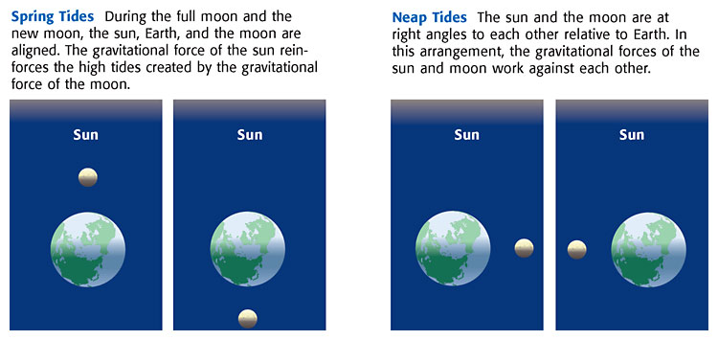

Slide 16
Neap Tides
When the sun, Earth, and moon form a 90° angle, neap tides occur.
Neap tides are tides with the smallest daily tidal range and occur during the first and third quarters of the moon.
Neap tides occur halfway between the occurrence of spring tides.
When neap tides occur, the gravitational forces on the Earth by the sun and moon work against each other.

Slide 17
Tides and Topography
After a tidal range has been measured, the times that tides occur can be accurately predicted.
This information can be useful for people who live near or visit the coast, as shown in Figure 5.
In some coastal areas that have narrow inlets, movements of water called tidal bores occur.
A tidal bore is a body of water that rushes up through a narrow bay, estuary, or river channel during the rise of high tide and causes a very sudden tidal rise.
Tidal bores occur in coastal areas of China, the British Isles, France, and Canada.

Slide 18
