Slide 1
Chapter 3 Section 1

Slide 2
The Big Idea
Minerals have characteristic physical and chemical properties that determine how each mineral is used by humans.

Slide 3
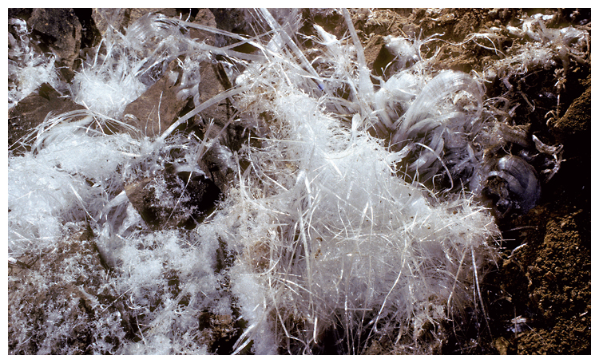
The white substance on these rocks may look like cotton candy, but the substance is actually the mineral epsomite. Epsomite is a sulfite mineral that can form in caves. Epsomite crystals can appear needlelike, hairlike, or cottonlike. This sample of epsomite is from Ellison’s Cave in Georgia.

Slide 4
What Is a Mineral?
You may think that all minerals look like gems. But, in fact, most minerals look more like rocks.
Does this mean that minerals are the same as rocks? Well, not really. So, what’s the difference?
For one thing, rocks are made of minerals, but minerals are not made of rocks. A mineral is a naturally formed, inorganic solid that has a definite crystalline structure.

Slide 5
Mineral Structure
By answering the four questions, you can tell whether an object is a mineral.
If you cannot answer “yes” to all four questions, you don’t have a mineral. Three of the four questions may be easy to answer.
The question about crystalline structure may be more difficult.

Slide 6
4 questions
Is it a nonliving material?
Is it a solid?
Is it found in nature?
Does it have a crystalline structure?
  Does it have the same chemical composition throughout?
  Does it contain one or more of any element

Slide 7
Atoms and Compounds
Each element is made of only one kind of atom.
An atom is the smallest part of an element that has all the properties of that element.
Like other substances, minerals are made up of atoms of one or more elements

Slide 8
Most minerals are made of compounds of several different elements.
A compound is a substance made of two or more elements that have been chemically joined, or bonded.
A mineral that is composed of only one element is called a native element.

Slide 9
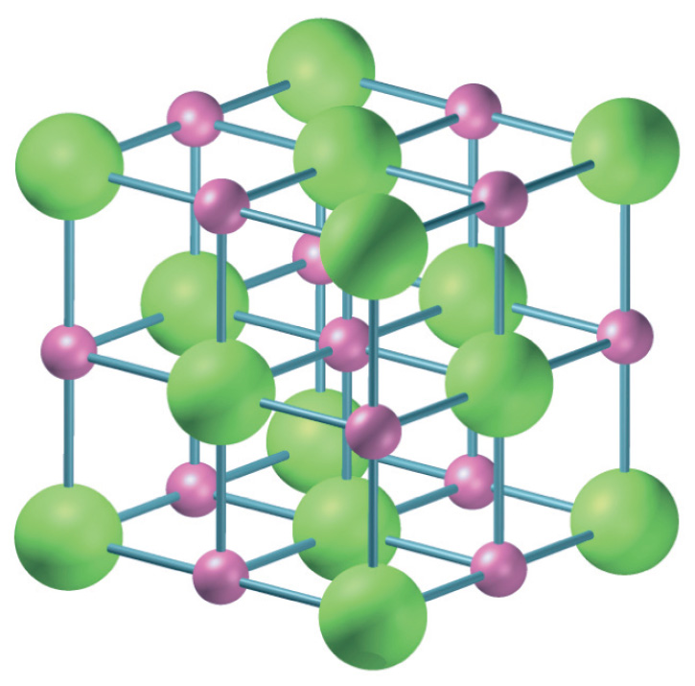
Sodium

Slide 10
Crystals
Solid, geometric forms of minerals produced by a repeating pattern of atoms or molecules that is present throughout the mineral are called crystals.
A crystal’s shape is determined by the arrangement of the atoms or molecules within the crystal.

Slide 11
Crystals Continued
The arrangement of atoms or molecules in turn is determined by the kinds of atoms or molecules that make up the mineral.
Each mineral has a definite crystalline structure. All minerals can be grouped into crystal classes according to the kinds of crystals they form

Slide 12
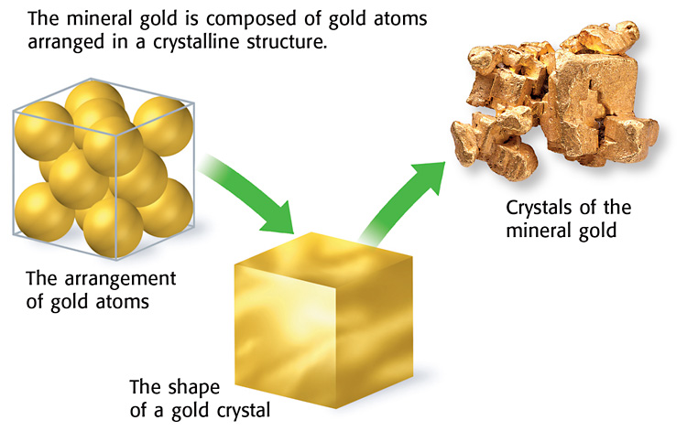

Slide 13
Two Groups of Minerals
Silicate Minerals
  Silicon and oxygen are the two most common elements in the Earth’s crust. Minerals that contain a combination of these two elements are called silicate minerals.
  Silicate minerals make up more than 90% of the Earth’s crust. The rest of the Earth’s crust is made up of non-silicate minerals.

Slide 14
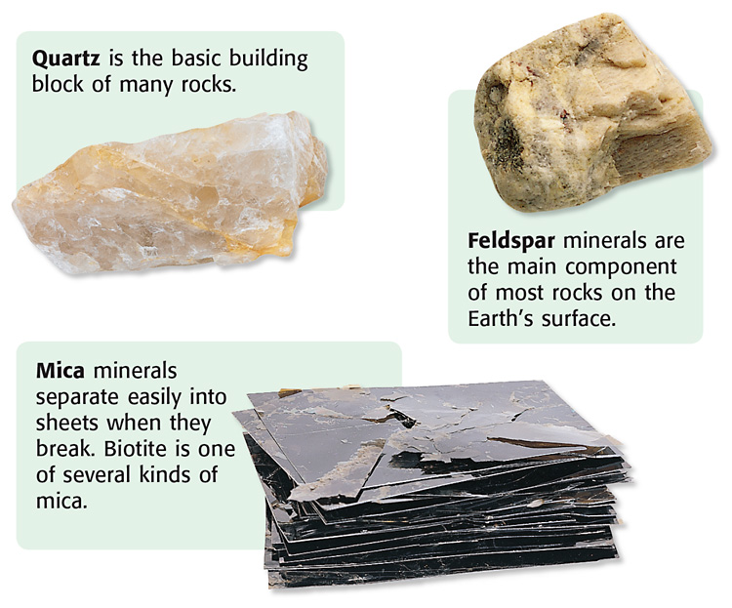

Slide 15
Nonsilicate Minerals
Minerals that do not contain a combination of the elements silicon and oxygen form a group called the nonsilicate minerals.
Some of these minerals are made up of elements such as carbon, oxygen, fluorine, and sulfur.

Slide 16
