Slide 1
Chapter 3 Section 3

Slide 2
The Formation, Mining, and Use of Minerals
What You Will Learn
Describe the environments in which minerals form.
Compare the two types of mining.
Describe two ways to reduce the effects of mining.
Describe different uses for metallic and nonmetallic minerals.

Slide 3
Minerals and Environments
Minerals form in a variety of environments in the Earth’s crust.
Each of these environments has a different set of physical and chemical conditions.
Therefore, the environment in which a mineral forms determines the mineral’s properties.
Environments in which minerals form may be on or near the Earth’s surface or deep beneath the Earth’s surface.

Slide 4
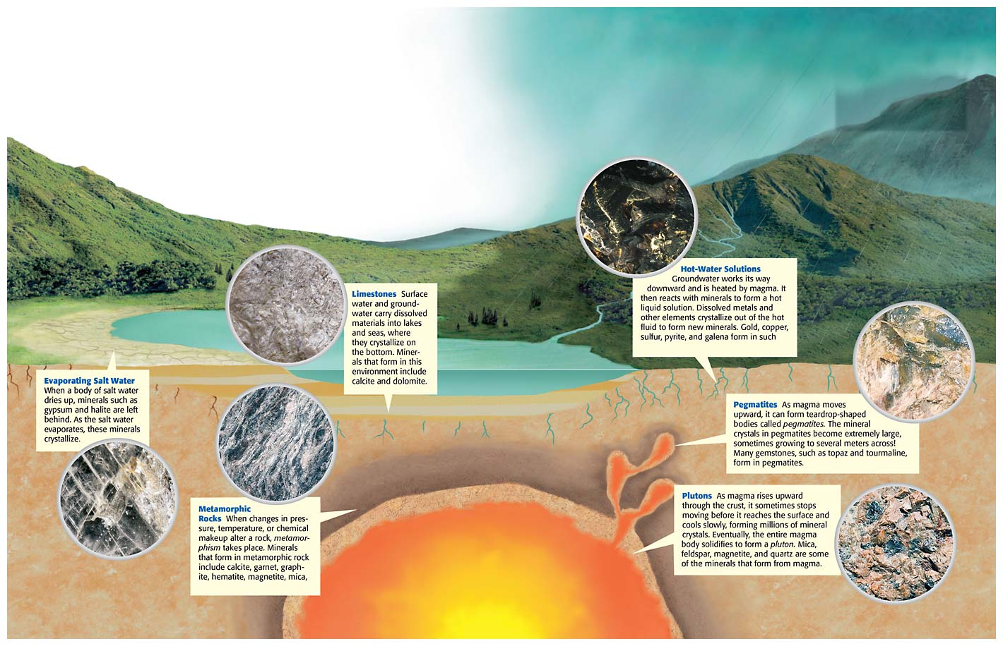

Slide 5
Mining
Many kinds of rocks and minerals must be mined to extract the valuable elements they contain.
Geologists use the term ore to describe a mineral deposit large enough and pure enough to be mined for profit.

Slide 6
Mining Continued
Rocks and minerals are removed from the ground by one of two methods
  Surface mining or subsurface mining
The method miners choose depends on how close to the surface or how far down in the Earth the mineral is located.

Slide 7
Surface Mining
When mineral deposits are located at or near the surface of the Earth, surface-mining methods are used to remove the minerals.
Types of surface mines include open pits, surface coal mines, and quarries.

Slide 8
Open-pit Mining
Open-pit mining is used to remove large, near-surface deposits of economically important minerals such as gold and copper.
Ore is mined downward, layer by layer, in an open-pit mine.
Explosives are often used to break up the ore.

Slide 9
Quarries
Quarries are open pits that are used to mine building stone, crushed rock, sand, and gravel.
Coal that is near the surface is removed by surface coal mining.
Surface coal mining is sometimes known as strip mining because the coal is removed in strips that may be as wide as 50 m and as long as 1 km.

Slide 10
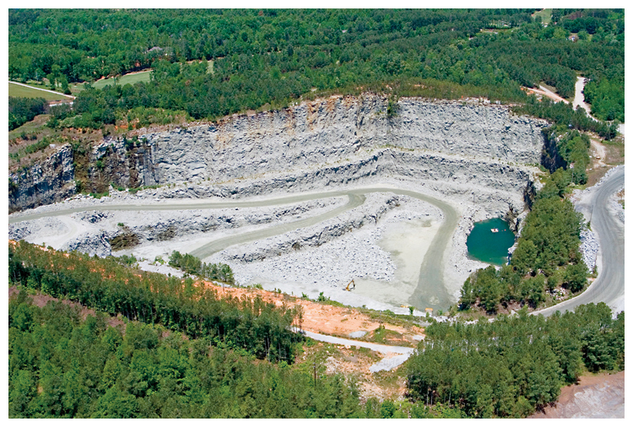
This quarry in northwest Georgia is an open pit used to mine granite.

Slide 11
Subsurface Mining
Subsurface mining methods are used when mineral deposits are located too deep within the Earth to be surface mined.
Subsurface mining often requires that passageways be dug into the Earth to reach the ore.
If a mineral deposit extends deep within the Earth, however, a vertical shaft is sunk.

Slide 12
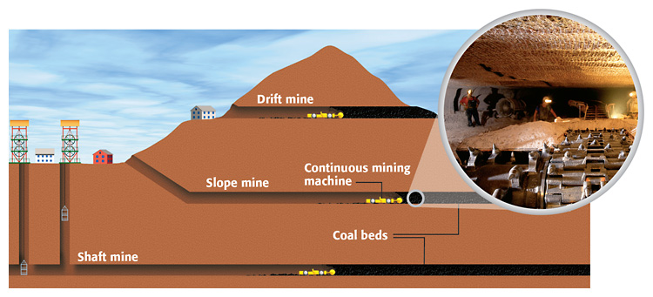

Slide 13
Responsible Mining
Mining gives us the minerals we need, but it may also create problems.
Mining can destroy or disturb the habitats of plants and animals.
Also, the waste products from a mine may get into water sources, which pollutes surface water and groundwater.

Slide 14
Mine Reclamation
One way to reduce the potential harmful effects of mining is to return the land to its original state after the mining is completed.
The process by which land used for mining is returned to its original state or better is called reclamation.
Reclamation of mined public and private land has been required by law since the mid-1970s.

Slide 15
The Use of Minerals
Mineral Uses
Copper - electrical wire, plumbing, coins
Diamond - jewelry, cutting tools, drill bits
Galena - batteries, ammunition
Gibbsite - cans, foil, appliances, utensils
Gold -jewelry, computers, spacecraft, dentistry
Gypsum - wallboards, plaster, cement
Halite - nutrition, highway de-icer, water softener
Quartz - glass, computer chips
Silver - photography, electronics products, jewelry
Sphalerite - jet aircraft, spacecraft, paints

Slide 16
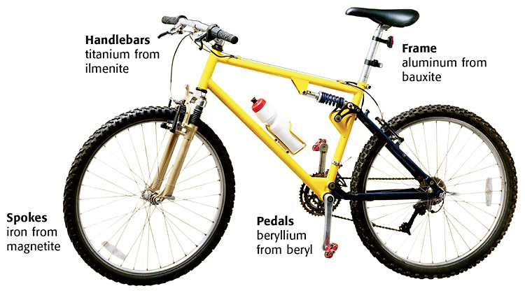

Slide 17
Metallic Minerals
Some minerals are metallic.
Metallic minerals have shiny surfaces, do not let light pass through them, and are good conductors of heat and electricity.
Metallic minerals can be processed into metals that are strong and do not rust. These properties make metals desirable for use in aircraft, automobiles, computers, communications and electronic equipment, and spacecraft.

Slide 18
Nonmetallic Minerals
Other minerals are nonmetals.
Nonmetallic minerals have shiny or dull surfaces, may let light pass through them, and are good insulators of electricity.
Nonmetallic minerals are some of the most widely used minerals in industry.
For example, calcite is a major component of concrete, which is used in building roads, buildings, bridges, and other structures.
Industrial sand and gravel, or silica, have uses that range from glassmaking to producing computer chips.

Slide 19
Gemstones
Some nonmetallic minerals, called gemstones, are highly valued for their beauty and rarity rather than for their usefulness.
Important gemstones include diamond, ruby, sapphire, emerald, aquamarine, topaz, and tourmaline.
Color is the most important characteristic of a gemstone.
  The mass of a gemstone is expressed in a unit known as a carat. One carat is equal to 200 mg.

Slide 20
