Slide 1
Chapter 7 Section 3

Slide 2
Standard
S6E5.d Recognize that lithospheric plates constantly move and cause major geological events on the earth’s surface.

Slide 3
What You Will Learn
Describe the three types of tectonic plate boundaries.
Describe the three forces thought to move tectonic plates.
Explain how scientists measure the rate at which tectonic plates move.

Slide 4
The Theory of Plate Tectonics
As scientists’ understanding of mid-ocean ridges and magnetic reversals grew, scientists formed a theory to explain how tectonic plates move.
Plate tectonics is the theory that the Earth’s lithosphere is divided into tectonic plates that move around on top of the asthenosphere.
In this section, you will learn what causes tectonic plates to move. But first you will learn about the different types of tectonic plate boundaries.

Slide 5
Tectonic Plate Boundaries
A boundary is a place where tectonic plates touch.
All tectonic plates share boundaries with other tectonic plates. These boundaries are divided into three types: convergent, divergent, and transform.
The type of boundary depends on how the tectonic plates move relative to one another. Tectonic plates can collide, separate, or slide past each other.
Earthquakes can occur at all three types of plate boundaries. The figure below shows examples of tectonic plate boundaries.

Slide 6
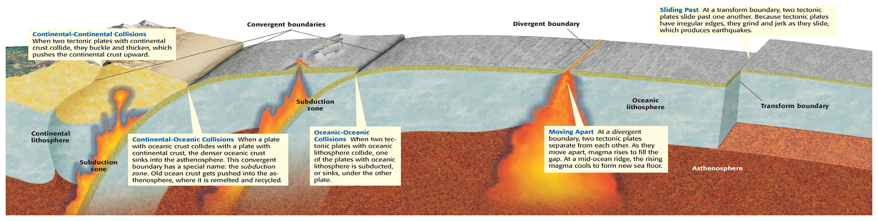

Slide 7
Convergent Boundaries
When two tectonic plates collide, the boundary between them is a convergent boundary.
What happens at a convergent boundary depends on the kind of crust at the leading edge of each tectonic plate.
The three types of convergent boundaries are continental-continental boundaries, continental-oceanic boundaries, and oceanic-oceanic boundaries.

Slide 8
Divergent Boundaries
When two tectonic plates separate, the boundary between them is called a divergent boundary.
New sea floor forms at divergent boundaries.
Mid-ocean ridges are the most common type of divergent boundary.

Slide 9
Transform Boundaries
When two tectonic plates slide past each other horizontally, the boundary between them is a transform boundary.
The San Andreas Fault in California is a good example of a transform boundary.
This fault marks the place where the Pacific and North American plates are sliding past each other.

Slide 10
Possible Causes of Tectonic Plate Motion
What causes the motion of tectonic plates?
Remember that the solid rock of the asthenosphere flows very slowly.
This movement occurs because of changes in density within the asthenosphere.
These density changes are caused by the outward flow of thermal energy from deep within the Earth.
When rock is heated, it expands, becomes less dense, and tends to rise to the surface of the Earth.
As the rock gets near the surface, the rock cools, becomes more dense, and tends to sink.

Slide 11
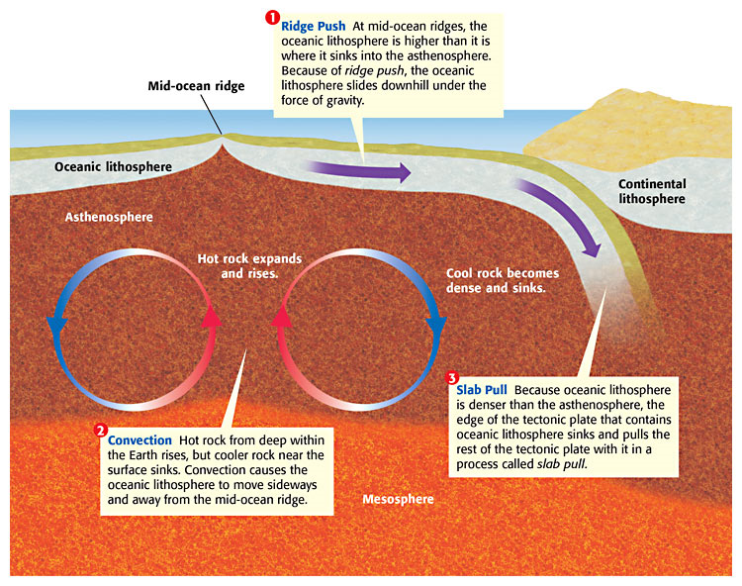

Slide 12
Tracking Tectonic Plate Motion
How fast do tectonic plates move?
The answer to this question depends on many factors, such as the type and shape of the tectonic plate and the way that the tectonic plate interacts with the tectonic plates that surround it. T
ectonic plate movements are so slow and gradual that you can’t see or feel them
  the movement is measured in centimeters per year.

Slide 13
The Global Positioning System
Scientists use a system of satellites called the global positioning system (GPS), to measure the rate of tectonic plate movement.
Radio signals are continuously beamed from satellites to GPS ground stations, which record the exact distance between the satellites and the ground station.
Over time, these distances change slightly.
By recording the time it takes for the GPS ground stations to move a given distance, scientists can measure the speed at which each tectonic plate moves.

Slide 14
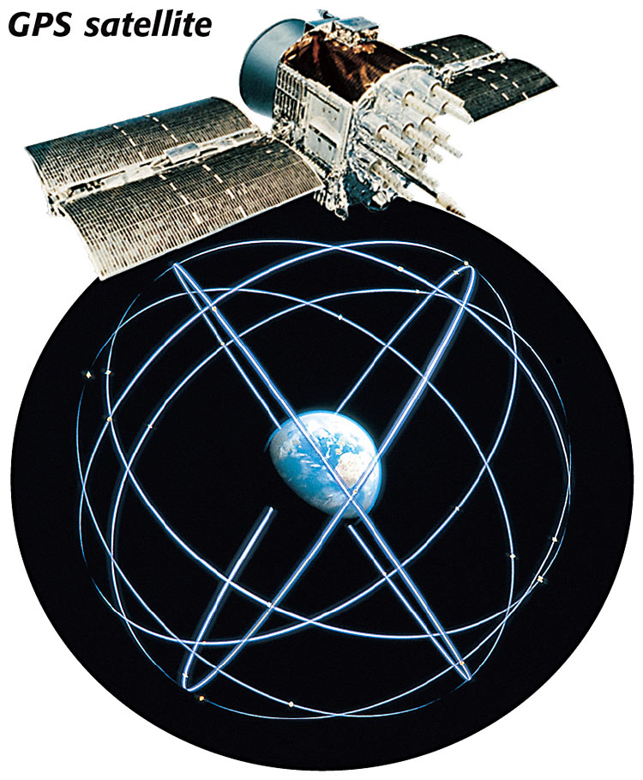

Slide 15
Section Summary
Boundaries between tectonic plates are classified as convergent, divergent, or transform.
Ridge push, convection, and slab pull are three possible driving forces of plate tectonics.
Scientists use data from a system of satellites called the global positioning system to measure the rate of motion of tectonic plates.

