Slide 1
Activating Strategy: Watch Ice Age: Scrat Continental Crack Up video clip and have students either answer individually or with a partner the following questions:
(1) Which part(s) of Scrat’s adventure is accurate? (2) Which part(s) of Scrat’s adventure is not accurate?
Notes:
Share and discuss with the class.

Slide 2
Essential Question: How does the constant movement of lithospheric plates cause major geological events on the earth’s surface?
Standard:
S6E5e. Recognize that lithospheric plates constantly move and cause major geological events on the Earth’s surface.

Slide 3
One of the accurate events shown in Scrat’s Continental Crack Up is that the continents were once joined together but moved apart.
An inaccurate representation is that the break-up and moving of the continents occurred quickly.
https://www.youtube.com/watch?v=ft-dP2D7QM4&index=1&list=PL5D8C1AA3D9734764

Slide 4
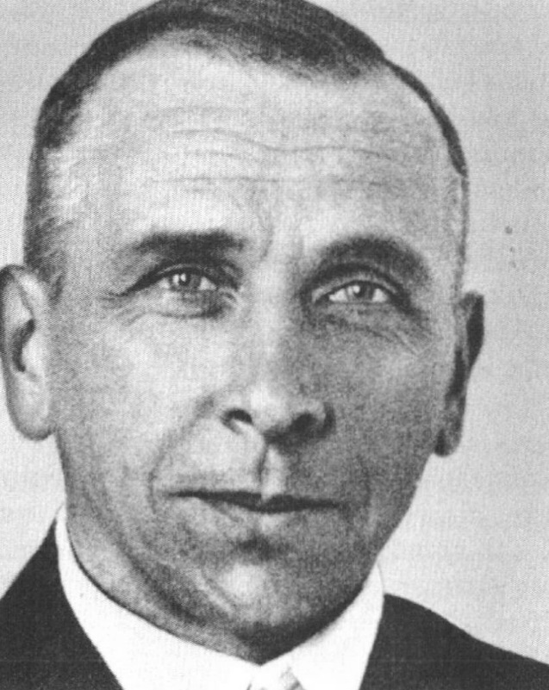
In 1912, a man named Alfred Wegener proposed that at one time the continents were joined together, but over time have moved slowly to their current locations. His hypothesis is called Continental Drift.

Slide 5
Wegener called the once connected large landmass Pangaea.

Slide 6
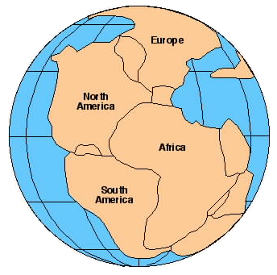
Other than the “puzzlelike” fit of the separated continents, what evidence was used to support the Theory of Continental Drift?

Slide 7
Rock, fossil, and climate clues were the main types of evidence for continental drift. Advances in technology have provided additional clues to help explain continental drift.

Slide 8
Continental Drift Video
http://www.sciencechannel.com/tv-shows/greatest-discoveries/videos/100-greatest-discoveries-continental-drift/
or
https://www.youtube.com/watch?v=0KNqUwgqbZw
Continental Drift Song
https://www.youtube.com/watch?v=T1-cES1Ekto

Slide 9
Turn to an elbow partner and discuss the following:
Will the continents continue to move? How do you know?
http://www.classzone.com/books/earth_science/terc/content/visualizations/es0807/es0807page01.cfm?chapter_no=visualization

Slide 10
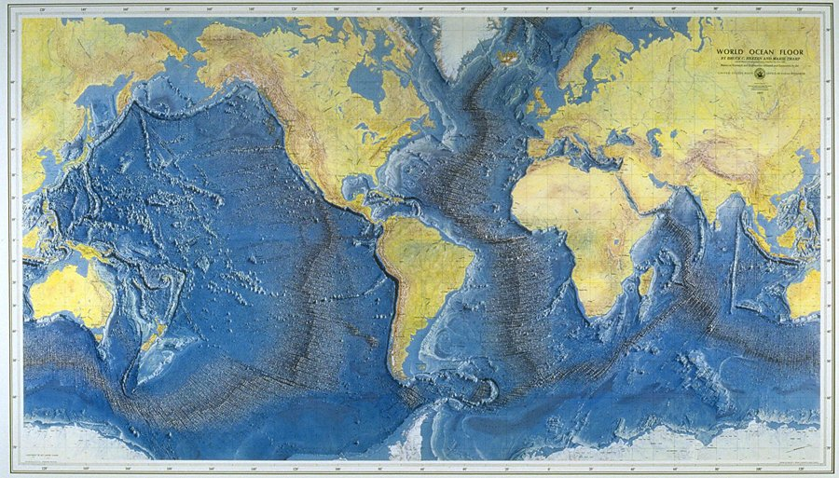
During the 1940s and 1950s, using technology developed during World War I, scientists began using sound waves to map the ocean floor.

Slide 11
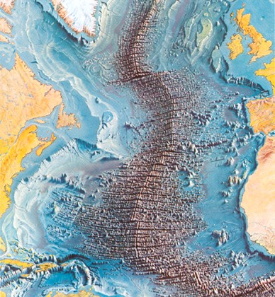
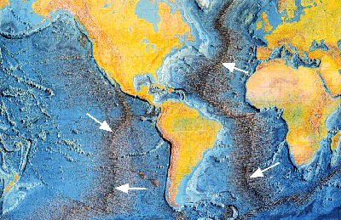
Researchers discovered an underwater system of ridges (mountains) and valleys like those found on the continents.

Slide 12
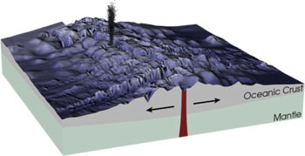
The theory of seafloor spreading explains the formation of the underwater mountain ranges.

Slide 13
Seafloor Spreading
Hot, less dense material below the Earth’s crust rises toward the surface at the mid-ocean ridges.
The seafloor spreads apart and magma is forced upward pushing the older seafloor away from the ridge in opposite directions.
The magma becomes solid as it cools and sinks forming new seafloor.

Slide 14
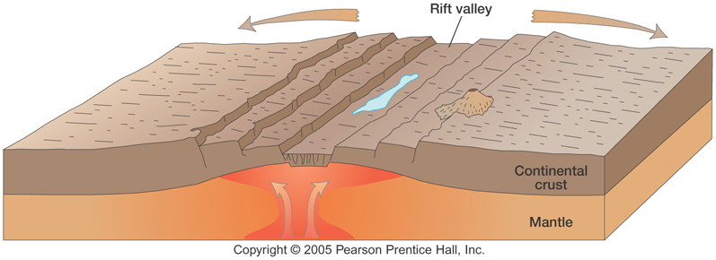
Seafloor Spreading
http://www.absorblearning.com/media/attachment.action?quick=12n&att=2771

Slide 15
Seafloor Spreading Video Clip
http://www.sciencechannel.com/tv-shows/greatest-discoveries/videos/100-greatest-discoveries-sea-floor-spreading.htm
or
https://www.youtube.com/watch?v=0KNqUwgqbZw

Slide 16
If new crust is being added by seafloor spreading, does the Earth’s surface just keep expanding?
Let’s continue to find out.

Slide 17
No, it does not keep expanding, but what happens to it?
Let’s continue to find out.

Slide 18
The idea of seafloor spreading showed that more than just the continents were moving, as continental drift had shown.
Scientists now believe that sections of the seafloor and continents move in relation to one another.

Slide 19
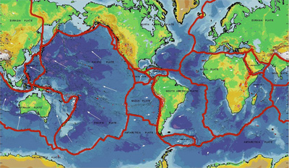
A new theory that combined continental drift and seafloor spreading was developed known as the theory of Plate Tectonics.

Slide 20
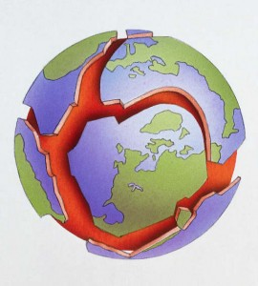
The theory of Plate Tectonics states that the Earth’s crust and part of the Upper Mantle are broken into plates (sections) that move.

Slide 21
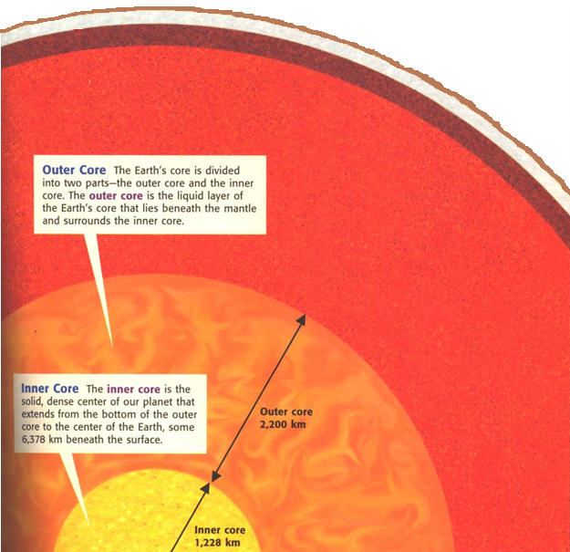
Crust
The “plates” of the lithosphere float and move around on the asthenosphere.
Mantle
Outer Core
Liquid
Lithosphere – Crust and Upper Layer of the Mantle
Layer of the Mantle (asthenosphere) that consists of hot rock of tar-like consistency, which slowly moves
Inner Core Solid
https://www.youtube.com/watch?v=Z9Hr7V1S0pI

Slide 22
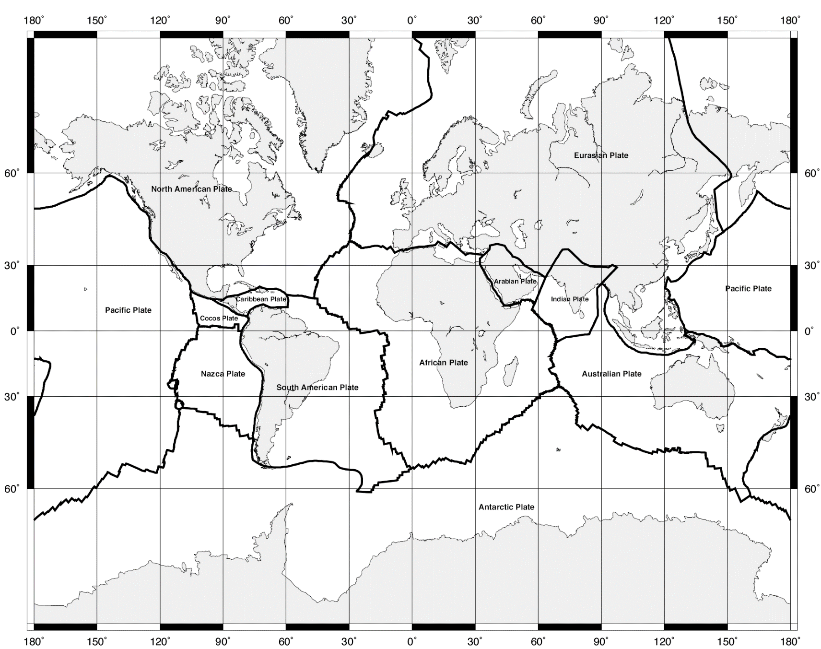
Plate Boundary Map

Slide 23
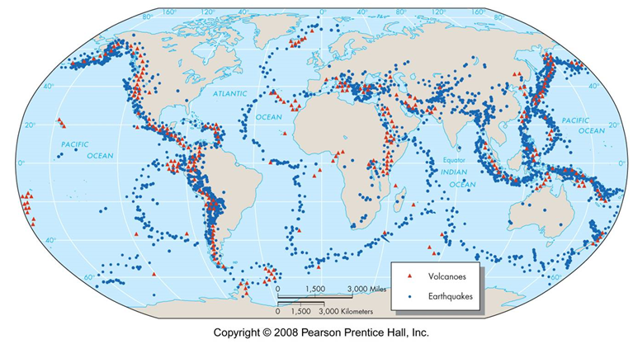
Volcanoes and Earthquakes form along tectonic plate boundaries? But Why?

Slide 24
When plates move, they can interact in several ways:
They can move toward each other
They can pull apart from each other
They can slide alongside one another
The result of plate movement can be seen at plate boundaries.

